Slide 1


Slide 2
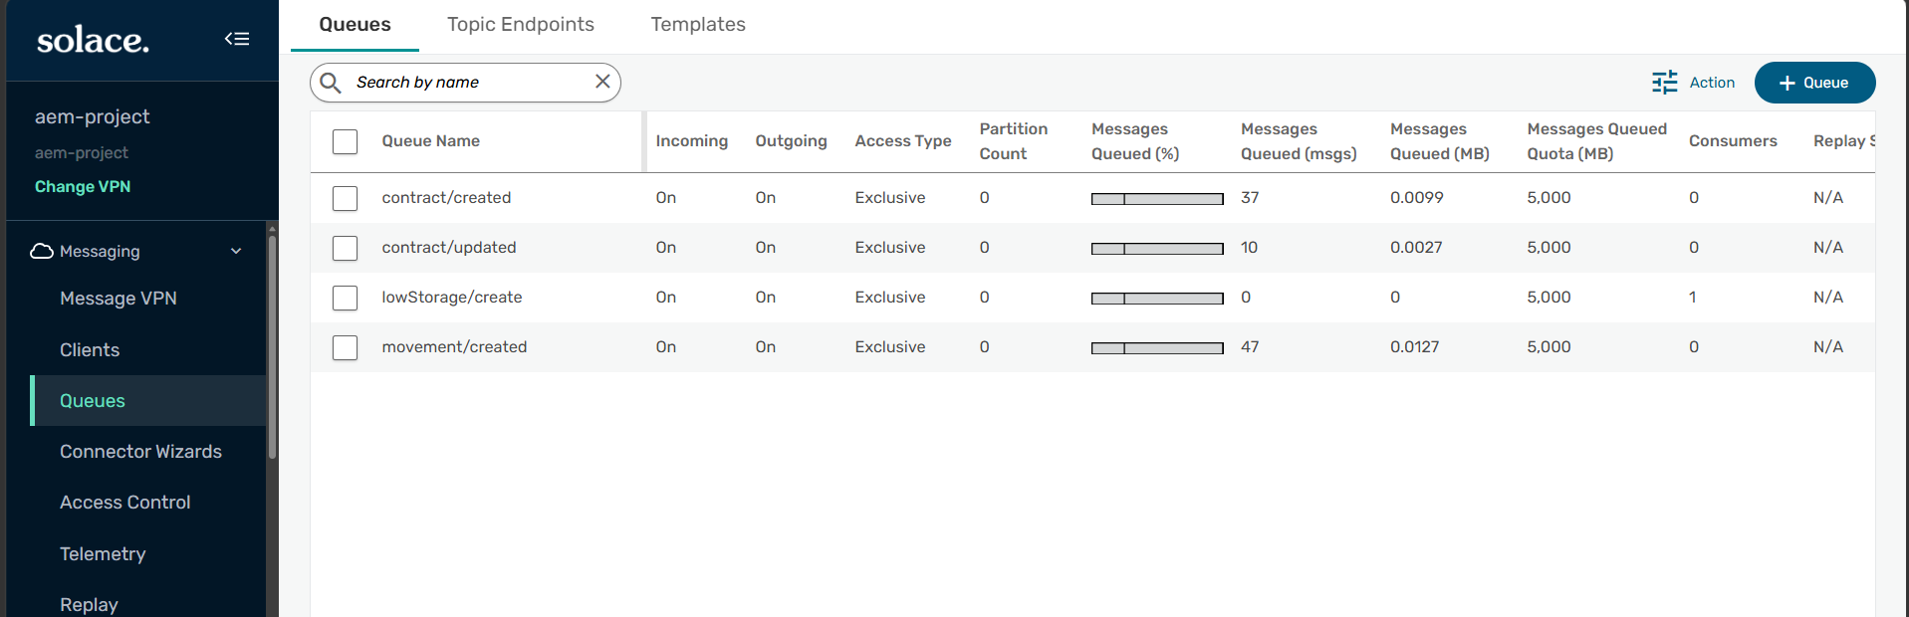
Advanced Event Mesh
We're going to explore how to send and receive messages from the Advanced Event Mesh queue using our integration flows.

Slide 3
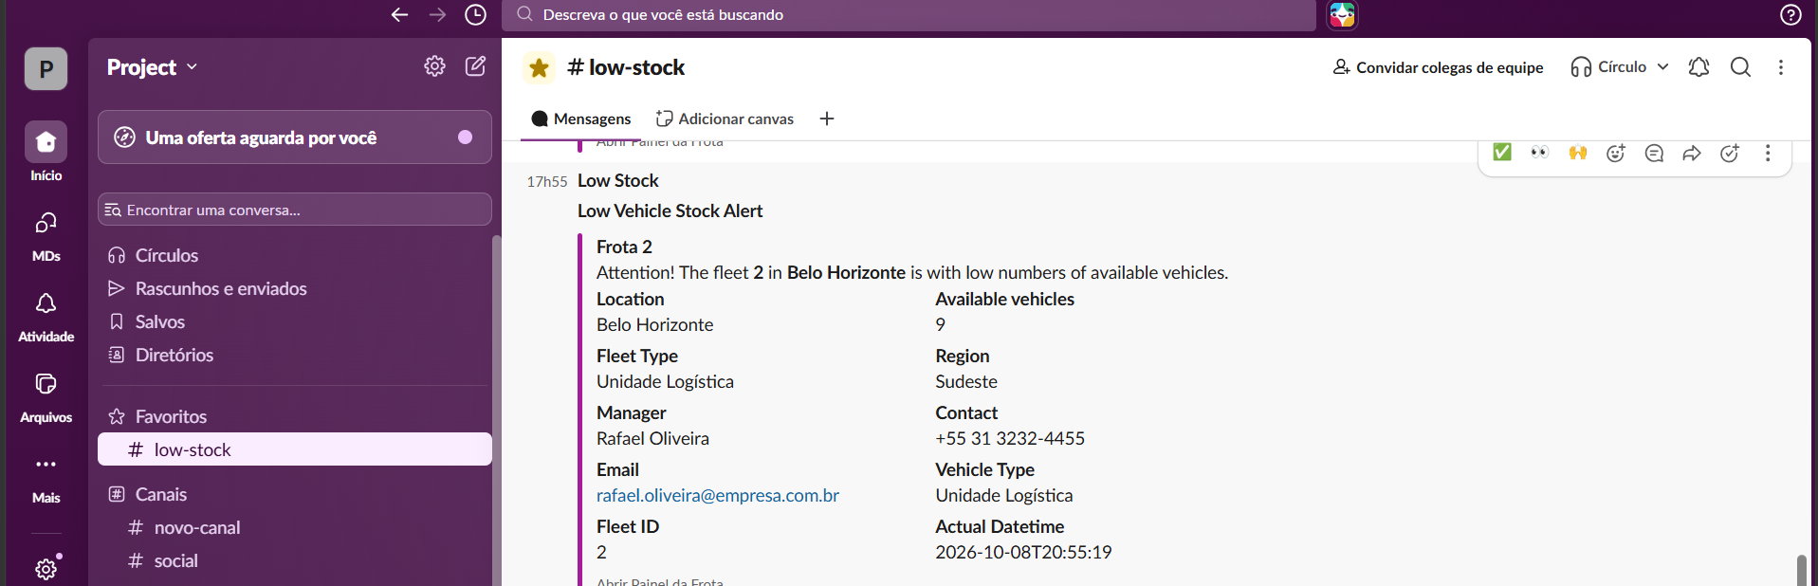
Open Connectors
We'll see how to get our data from the Advanced Event Mesh queue, process it, and send it as a message to the Slack platform.

Slide 4
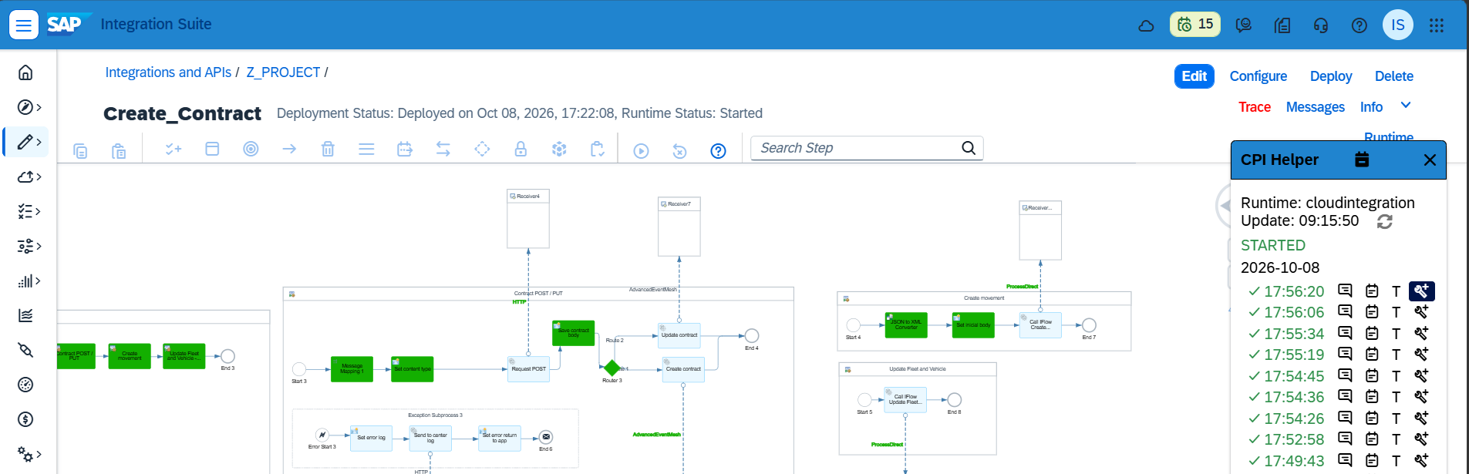
Integration Flows
Examples of robust integration flows with subprocesses, exception subprocesses, ProcessDirect, HTTP, Open Connectors, and Advanced Event Mesh calls.

Slide 5
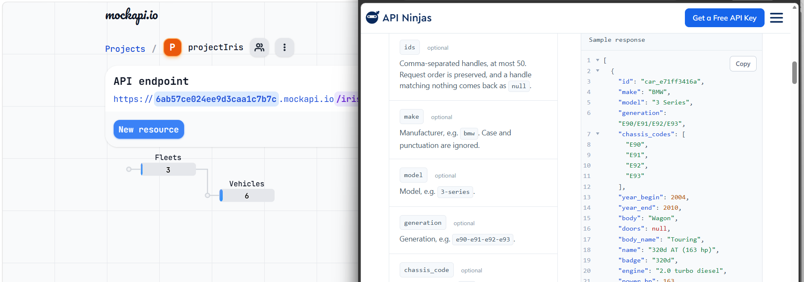
Join Open APIs
Examples of combining Open APIs from MockAPI and API Ninjas into a single response.

Slide 6
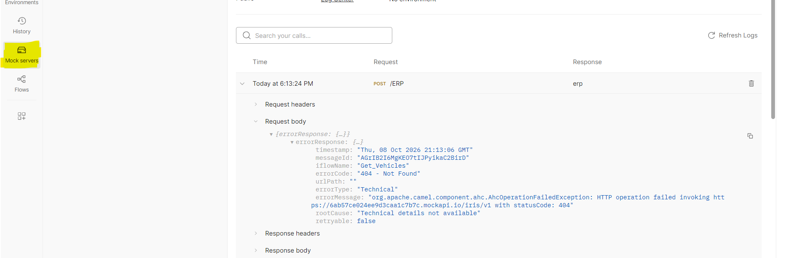
Postman: Mock Server
How to use a mock server in Postman to create an error log.

